Slide 1
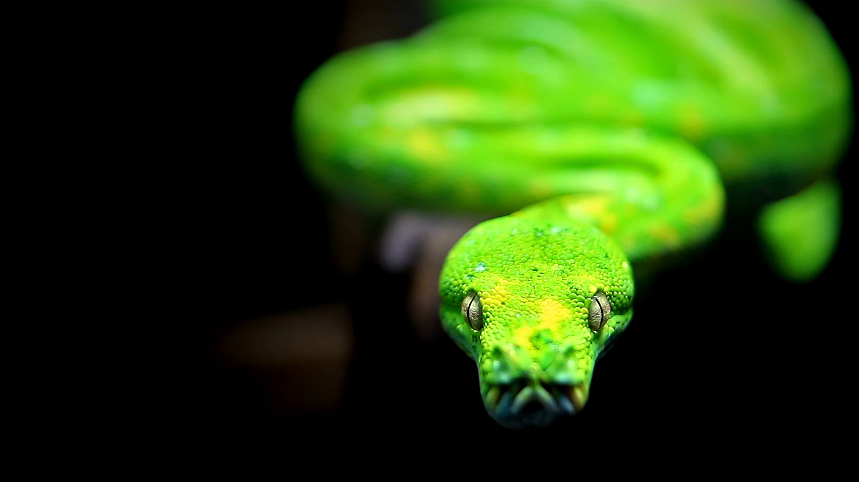
GARIKE VIVEK MUVVA MUKESH

Slide 2
Comparison of Search-based and Reinforcement Learning Agents in Solving the Game of Snake

Slide 3
Objectives
Design search-based Learning agents and Reinforcement-based Learning agents to solve the game
Design 4 Learning agents (3 – search based and 1- Reinforcement agents)
Play snake game with all these learning agents
Snake game logic depends on
1)Snake grows when it eats food.
2)Snake dies when it hits the wall or if it bites itself.
Comparing the difference between search-based Reinforcement Learning agents

Slide 4
Approach
These are the Learning Agents we are choosing:
Search-based Learning agents
1) Breadth First Search
2) Depth First Search
3) Hamilton Search
Reinforcement-based Learning agents
1) Q-Learning Agents
Technology Stack
Python3
Pygame

Slide 5
Deliverables
User documentation manual which gives details about the snake game implementation using search-based and reinforcement learning agent.
Algorithms developed for Learning agent using python programming language(.py files)
GitHub repository link for project code and related files.
YouTube video demonstrating project implementation and slides.

Slide 6
Evaluation Methodology
Project is evaluated based on the implementation of all the learning agents.
A comparison table given for all the Learning agents based on the snake average length and average steps.
Graphs depicting the performance comparisons.
Optimal time and space complexity for all the Learning agents implemented.
The results mentioned shouldn’t be vague and give a categorical inference to user to choose the learning agent.
As it’s a team project, the contribution of the teammates and their communication should also be considered.

Slide 7
User Interface
The grid is divided into two equal parts
The first half is allocated for the snake game.
The second half is to track the snake length and steps travelled before it dies.
The snake travels in a grid of 8*8.
The maximum length a snake could achieve is of size 64
The snake’s average length and steps for each agent helps us to determine the best agent.
We are comparing all the agents based on these two factors

Slide 8
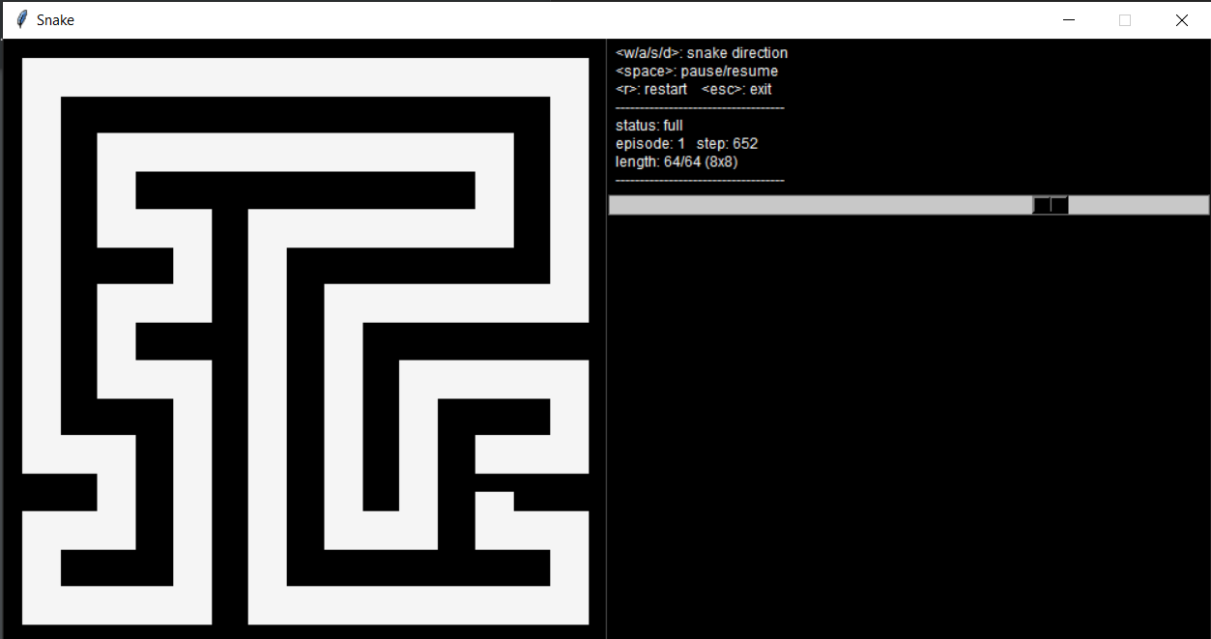
Results

Slide 9
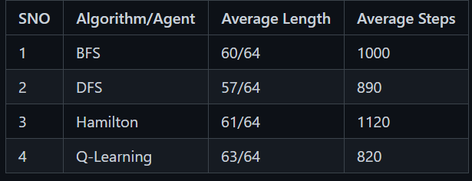
Results

Slide 10
Analysis
While running Q-learning for the first 5-10 times, the snake died freqently because of the unstable Q-Table. But after training atleast 10 times the snake started growing fast and it achieved maximum length. The BFS and DFS were almost same, but the BFS doing better than DFS and Hamilton but less than Q-Learning. With a proper Q-Table the BFS, DFS and hamilton couldn't beat Q-Learning. Although updating of Q-table takes time but a good approach for this game.

Slide 11
THANK YOU

